Slide 1

WSO2 Enterprise Service Bus
Modern Topics in Information Technology
4th Year – Semester 1
By Udara Samaratunge

Slide 2
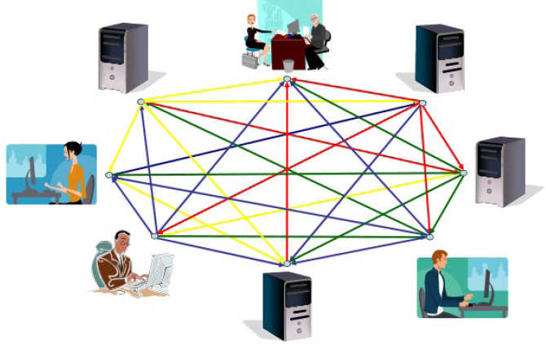
Service Oriented Architecture - SOA

Slide 3
SOA Evolution
Main Frames – Used Tapes to transfer files
Later lower level socket based communication was used
Then came, Network File System (NFS) and File Transfer Protocols (FTP)
Remote Procedure Calls (RPCs) got matured along with the improved of server hardware
CORBA came in but the advent of Java resulted the demise of CORBA
DCOM came in but its proprietary nature resulted its demise
SOAP relies on XML as the payload, which has got much higher degree of interoperability between programming languages.

Slide 4
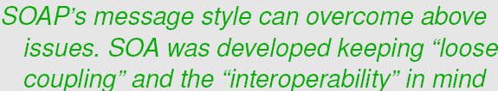
Problems related to RPC
Tight coupling between local and remote systems requires significant bandwidth demands
Interoperability issues – Mainly due to incompatible data types in different languages

Slide 5
Why SOA?
CORBA, EJB, DCOM introduced a highly coupled RPC. [Unlike SOA]
EJB and DCOM were tied to specific platforms and not at all inter-operable. [Unlike SOA]
EJB, DCOM and CORBA were more relied on commercial oriented products. [Unlike SOA]
SOA can be implemented using a completed “Open Source” Stack.
SOA relies on XML as the underlying data representation, unlike the others, which used proprietary binary-based objects
Unlike CORBA, EJB or DCOM, SOA is more than a RPC technology, It is a,
Governance
SLAs (Service Level Agreements)
Meta-data Definitions/ Registries

Slide 6
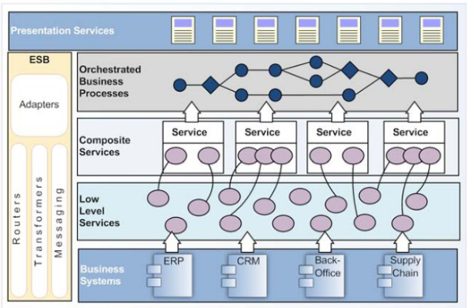
The SOA Environment

Slide 7
The characteristics of SOA
The service Interface/Contract
A service must have well defined interface contract.
This contract should identify,
The “operations” that are available through the service
“Data Requirements” for any “Exchanged Information”
WSDL (Web Service Description Language) is a good example for a service contract
Web services – Related technologies = XML / XML Schema
Web service use SOAP as communication Protocol. [Simple Object Access Protocol]
SOAP runs on HTTP protocol & uses default port 80. Message structured as XML.

Slide 8
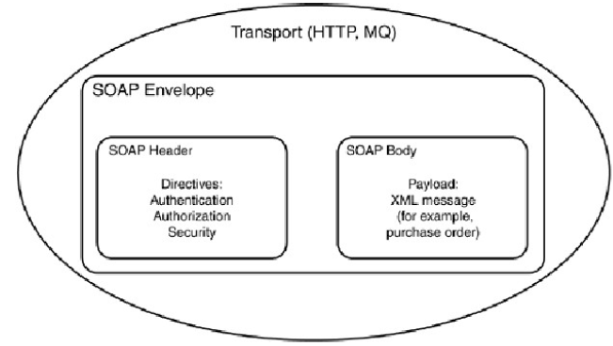
XML Messaging SOAP
The SOAP envelop is just a container to hold XML data.
SOAP envelope
SOAP Header – Contains information related to the message and its security
SOAP Body – Contains the message pay load
Requests are encoded in XML and sent via HTTP POST
Most firewalls allow HTTP traffic. This allows XML-RPC or SOAP messages to be used as HTTP messages.

Slide 9
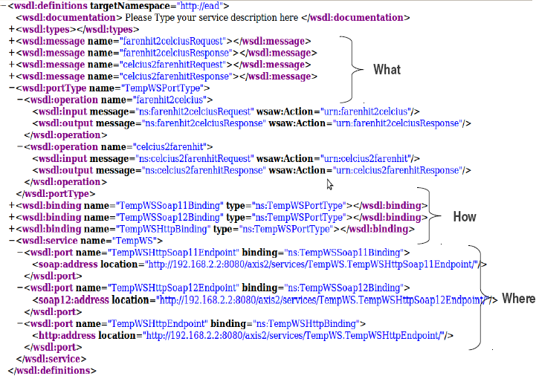
WSDL
Three Sections
What Section – Input and Output messages (<wsdl:types>, <wsdl:message>)
How Section – How messages should be packaged (bind) to different protocols in the SOAP envelop and how to transfer it (<wsdl:binding>)
Where Section – The endpoint details (<wsdl:service>)

Slide 10
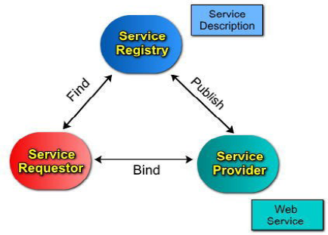
Web Services Model
UDDI is an XMLbased standard for describing, publishing, and finding Web services
UDDI = (Universal Description, Discovery and Integration)
UDDI uses WSDL to describe interfaces to web services
Service Provider: The provider of web service
Service Requester: The web service consumer
Service Registry: The central directory of services
Approaches of writing web service
Bottom-Up/Code First Approach [Implement web service method first]
Top-Down/Contract First Approach [Write WSDL first then generate Stub classes & Skeleton classes]
If you generate web services for different plat-forms (Java or .NET) which method is most suitable?

Slide 11
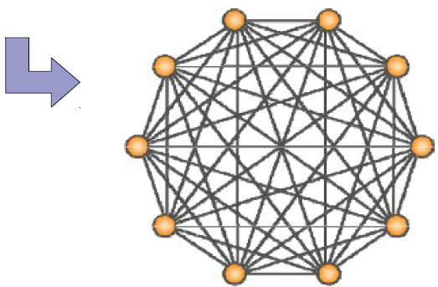
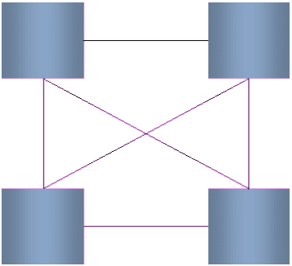
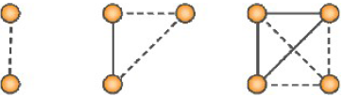
Point-to-Point Integration
Specifically, linking every component to every other component will require N(N-1)/2 physical connections
N = Total Number of Components in the Network
E.g: If there are 10 components in the network,
Total number of physical connections = 10 (10-1)/2 = 45
Benefits:
Provides a way to connect each other
Drawbacks:
Isolated without insufficient
Extremely “Spaghetti” like architecture, create headaches

Slide 12
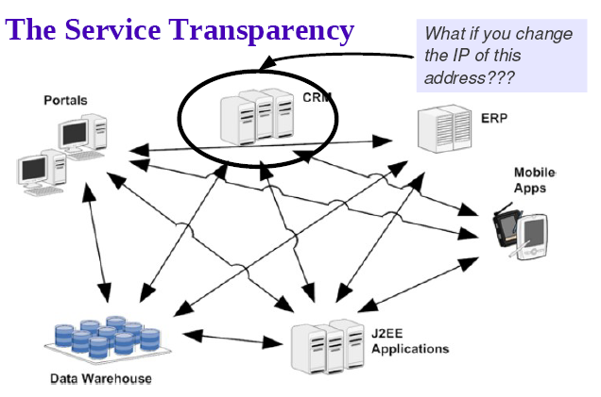
Why ESB?

Slide 13
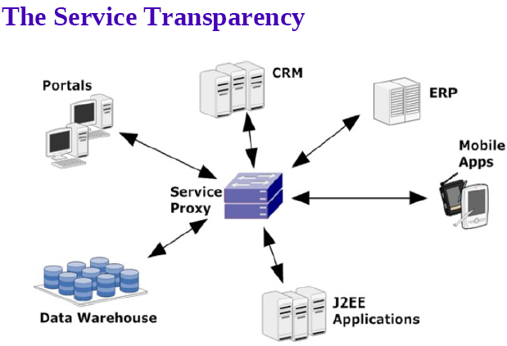
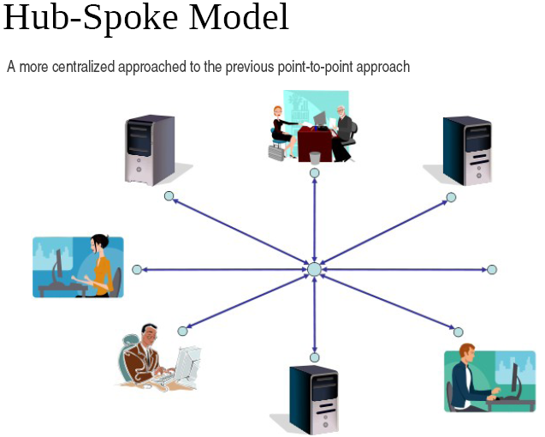
Solution for the Issue

Slide 14
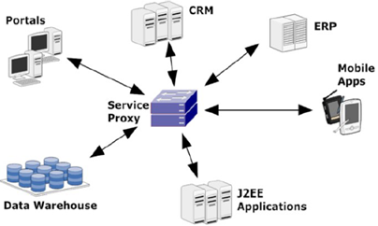
Solution from ESB
An ESB or a Service Proxy can be the solution to the mess created by the point-to-point approach. ESB = Enterprise Service Bus
All service calls are directed to the proxy or gateway, which in turn, forwards the message to the appropriate endpoint destination.
If an endpoint is changed, only the proxy configuration will be required to be changed.
Each component communicates with Proxy. Proxy should know how to send the message for destination.
Now component free from maintaining IP addresses of destination. That responsibility delegated to 3rd party module called ESB.
ESB mediate the message for exact endpoint based on proxy details.

Slide 15

What is an ESB?
ESB “is a software architecture model used for designing and implementing the interaction and communication between mutually interacting software applications in Service Oriented Architecture”
Promotes asynchronous message mediation
Message identification and routing between applications and services.
Allows messages to flow across different transport protocols
Transforming of messages
Allows secure, reliable communications
Extensible architecture (based on pluggable components)

Slide 16
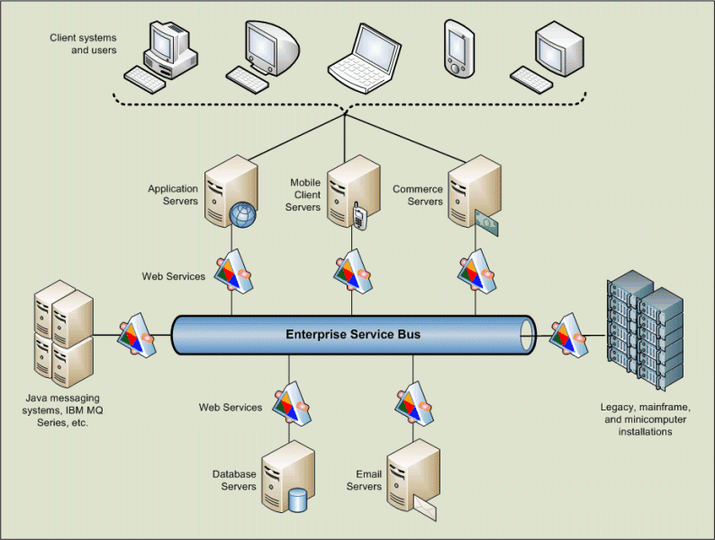
What is an ESB ? Cont.…

Slide 17
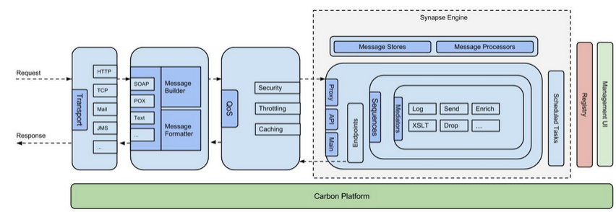
WSO2 ESB Architecture

Slide 18
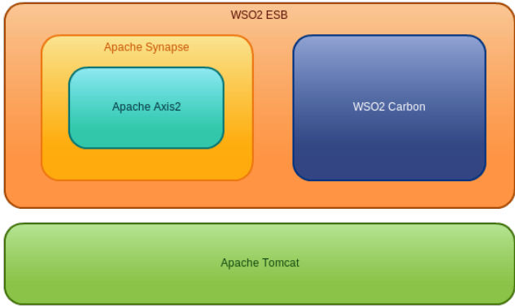


Technology Stack
WSO2’s core product, Middleware platform.
A dynamic component model built for Java
Components can be started, stopped, installed, uninstalled etc without reboot
Built on OSGi concepts
Powers SOA capabilities
EVERYTHING that WSO2 builds is based on Carbon
Apache Synapse:
Based on Axi2/Java
Acts a mediation library for different protocols
Supports different protocols through SOAP based Proxy Services

Slide 19





ESB Business Scenario.
Get photos from Dropbox publish them in the Facebook and send message for my friends through Twitter.
Notification
Requirement
ESB Proxy service
(6) Send Notification
(1) Request Photos
(5) Send messages for friends
(2) Download
Photos
(4) Published
Messages
(3) Publish
photos

Slide 20
Apache Synapse
Apache Synapse “is a lightweight and high-performance ESB with a powerful mediation engine.”
Default transport – HTTP-NIO (configurable pool of non-blocking worker threads)
Support for any request types XML, SOAP, plain text, binary, JSON and etc.
Supports any protocol HTTP, HTTPS, Mail (POP3, IMAP, SMTP), JMS, TCP, UDP, VFS, SMS, XMPP and FIX
Non-blocking HTTP/HTTPS transports
Support for WS-* standards (WS-Addressing, WS-Security and WS-Reliable Messaging)

Slide 21



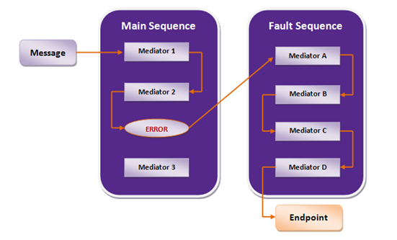
Flow of request
End point
ESB Proxy service
SOAP UI
ESB Template
In case an error occurs in the main sequence while processing, the message goes to the fault sequence.

Slide 22
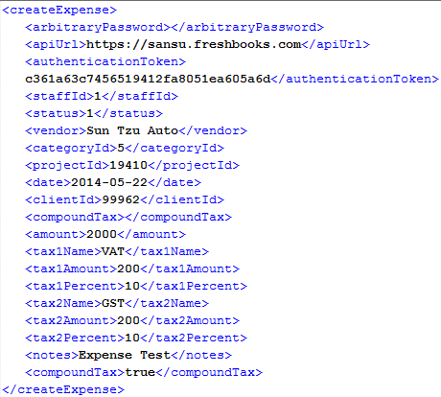
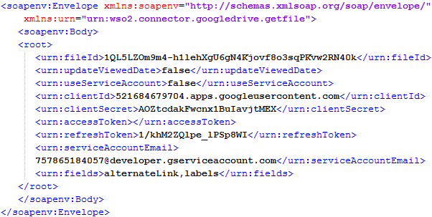
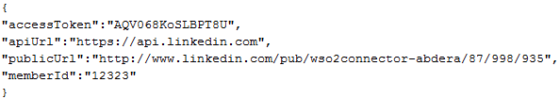
Sample Request types
POX Request
SOAP Request
JSON Request

Slide 23
Message Mediation
A mediator is the basic, full-powered message processing unit in the ESB.
A mediator can take a message, carry out some predefined actions on it, and output the modified message.
Usually, a mediator is configured using XML.
Different mediators have their own XML configurations.
At the run-time, a message is injected in to the mediator with the ESB run-time information.
Then this mediator can do virtually anything with the message.
A user can write a mediator and put it into the ESB.
Notes:
https://docs.wso2.com/display/ESB480/Mediators

Slide 24
Messaging
Messaging is a form of loosely coupled distributed communication.
‘Communication' can be understood as an exchange of messages between software components.
Message-oriented Middleware (MOM) attempt to relax tightly coupled communication (such as TCP network sockets, CORBA or RMI) by the introduction of an “intermediary component”.
MOMs allow software components to communicate 'indirectly' with each other.
Benefits of Messaging include message senders not needing to have precise knowledge of their receivers.
Thus any data that is to be transmitted via a messaging system must be converted into one or more messages

Slide 25
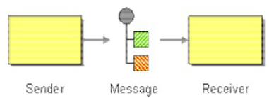
Message Structure
Message consist of two basic parts.
Header
– Describes the data being transmitted, its origin, its destination, MessageID, Timestamp, Priority, Delivery mode, Message type and etc.
Body
– The data being transmitted; generally ignored by the messaging system and simply transmitted as-is.
There are different kind of messages.
JMS Message
.NET Message
SOAP Message
Messaging play major role in Enterprise Application Integration.

Slide 26
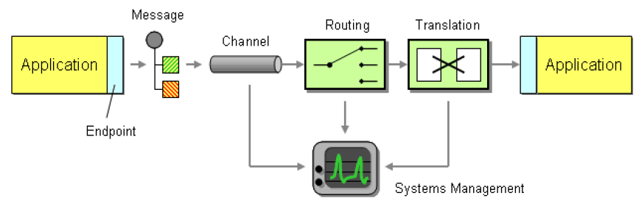
Enterprise Integration Patterns
There are 7 root patterns
Messaging
Message Channel
Message
Pipes and Filters
Message Router
Message Translator
Message Endpoint

Slide 27
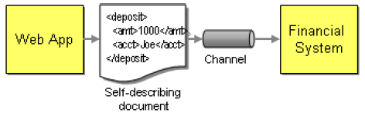
Enterprise Integration Patterns - Messaging
Messaging
Is a technology that enables high speed, “asynchronous”, program-to-program communication with reliable delivery.
Message itself is simply some sort of data structure such as a string, a byte array, a record, or an object
Messages
Programs communicate by sending packets of data called “messages” to each other.
First process marshals the data into a byte stream and copy it from the first process to the second process.
The second process unmarshal the data back to its original form.

Slide 28
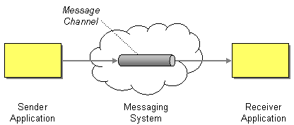
Enterprise Integration Patterns – Message channel
Message Channel
Messaging applications transmit data through a Message Channel, a virtual pipe that connects a sender to a receiver
The media that can move data from one application to the other

Slide 29

Enterprise Integration Patterns – Pipes and Filters
Use the Pipes and Filters architectural style to divide a larger processing task into a sequence of smaller, independent processing steps (Filters)
That are connected by channels (Pipes).
Each filter exposes a very simple interface.
The connection between filter and pipe is sometimes called port. In the basic form, each filter component has one input port and one output port.
We can add new filters, omit existing ones or rearrange them into a new sequence.

Slide 30
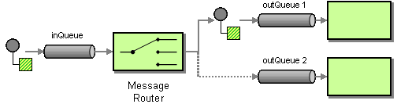
Message Router Pattern
Consumes a Message from one Message Channel and republishes it to a different Message Channel depending on a set of conditions.
A key property of the Message Router is that it does not modify the message contents.
If new message types are defined,
new processing components are added,
or the routing rules change,
we need to change only the Message Router logic and all other components remain unaffected

Slide 31
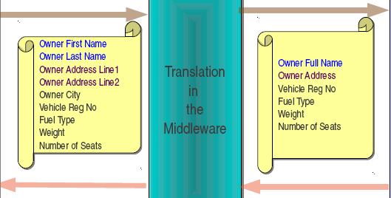
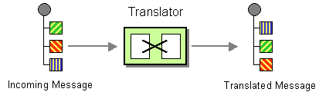
Message Translator Pattern
The Message Translator is the messaging equivalent of the Adapter pattern.
An adapter converts the interface of a component into a another interface so it can be used in a different context.
XSLT Mediators can be used for message transformation.

Slide 32
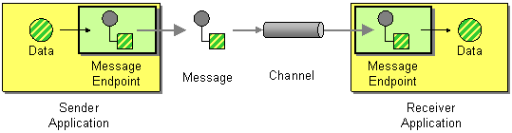
Message Endpoint Pattern
Connect an application to a messaging channel using a Message Endpoint.
A client of the messaging system that the application can then use to send or receive messages.
It is the endpoint that receives a message, extracts the contents, and gives them to the application in a meaningful way.

Slide 33
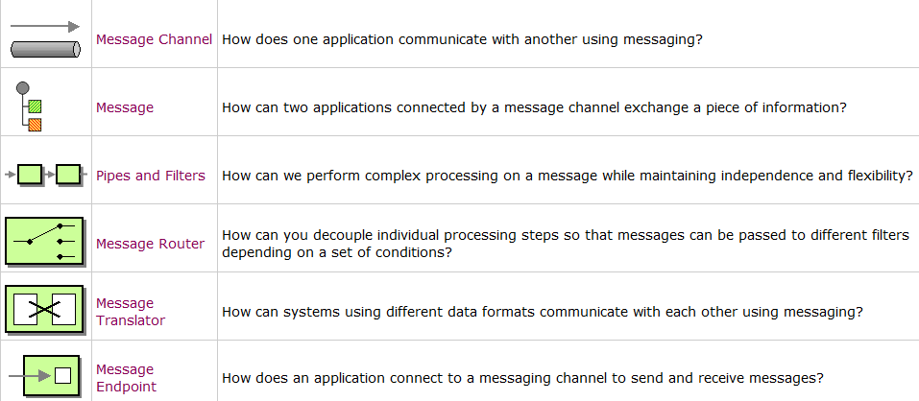
In a nutshell

Slide 34
Proxy Services
Pass Through Proxy - Forwards messages to the endpoint without performing any processing on them. This proxy service is useful as a catch-all, so that messages that do not meet the criteria to be handled by other proxy services are simply forwarded to the endpoint.
Secure Proxy - Uses WS-Security to process incoming requests and forward them to an unsecured backend service.
WSDL Based Proxy - A proxy service that is created from the remotely hosted WSDL of an existing web service. The endpoint information is extracted from the WSDL.
Logging Proxy - Logs all the incoming requests and forwards them to a given endpoint. It can also log responses from the backend service before routing them to the client.
Transformer Proxy - Transforms all the incoming requests using XSLT and then forwards them to a given endpoint. It can also transform responses from the backend service.
Custom Proxy - A custom proxy service in which you customize the sequences, endpoints, transports, and other QoS settings.

Slide 35
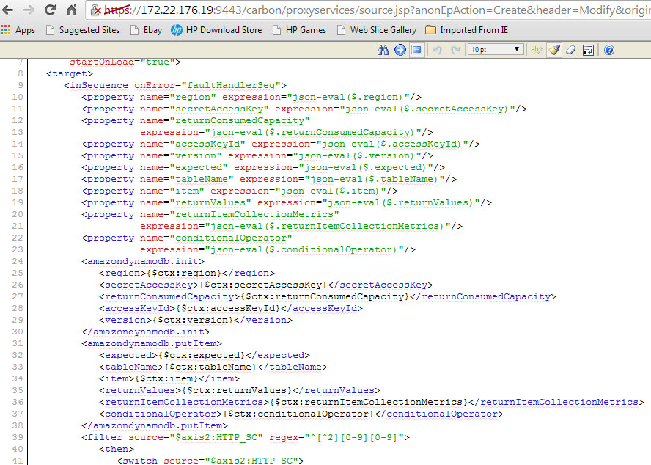
Custom proxy service.

Slide 36
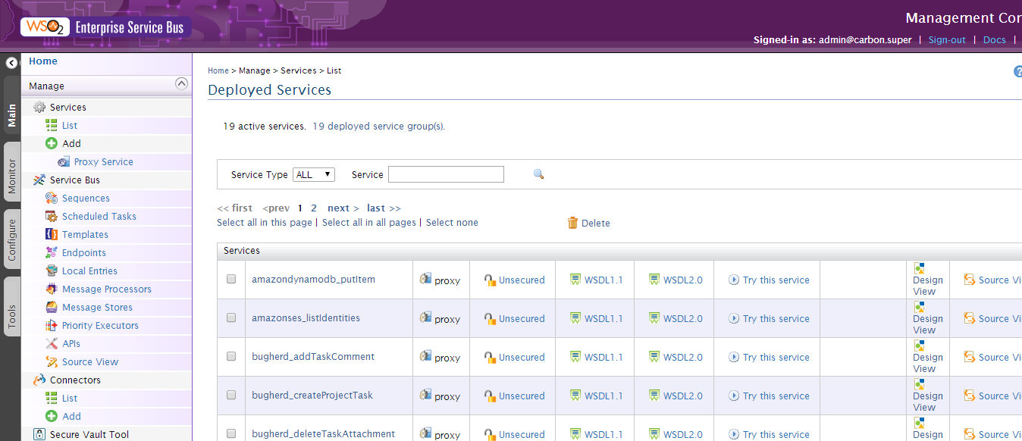
Sample proxy services

Slide 37
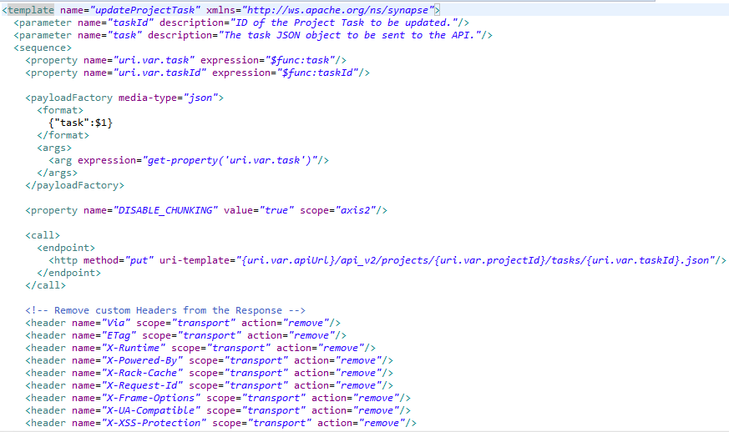
Connector Template Implementation

Slide 38
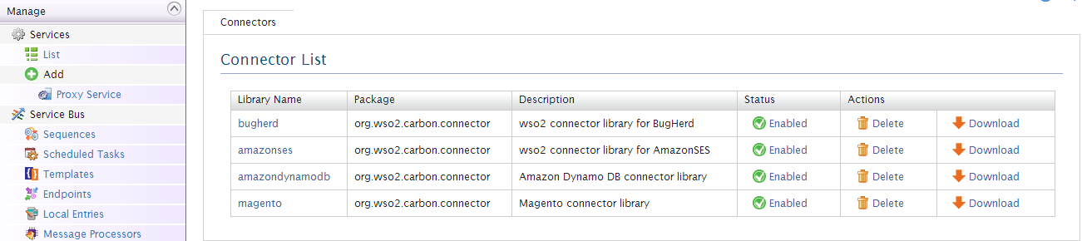
ESB Connector
Aggregation of mediators => is called sequence
Aggregation of sequences => is called template
Aggregation of templates => is called connector

Slide 39
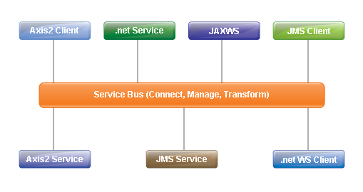
Service Bus and Mediation
Service Bus is the common communication channel that is used by all the parties in messaging.
Mediation is the process of facilitated communication between parties by providing intermediary conflict resolutions.

Slide 40
References
https://docs.wso2.com/display/ESB480/Using+a+Connector
https://docs.wso2.com/display/ESB480/JIRA+Connector
https://docs.wso2.com/display/ESB480/Managing+Connectors+in+Your+ESB+Instance
https://docs.wso2.com/display/ESB480/Mediators

